Slide 1
GRU8 – `Volume_ma` and `linear_series` feature

Slide 2
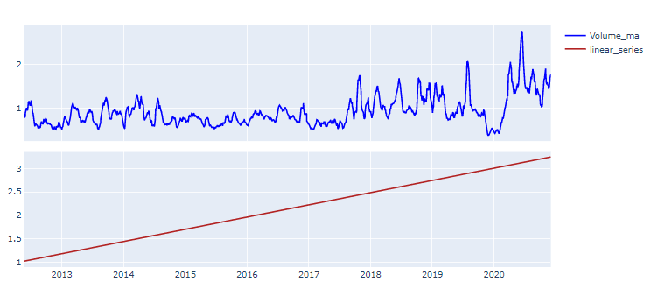
Volume_ma and linear_series feature

Slide 3
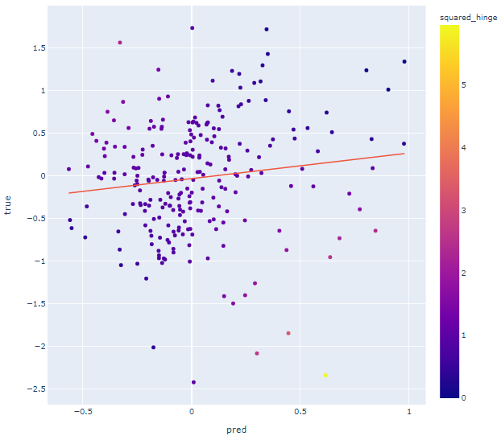
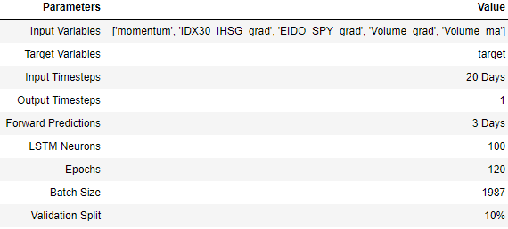
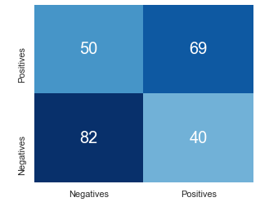
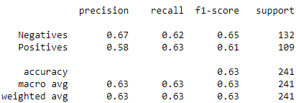
Test Result with `Volume_ma` feature
Model Parameters
Overall Accuracy

Slide 4
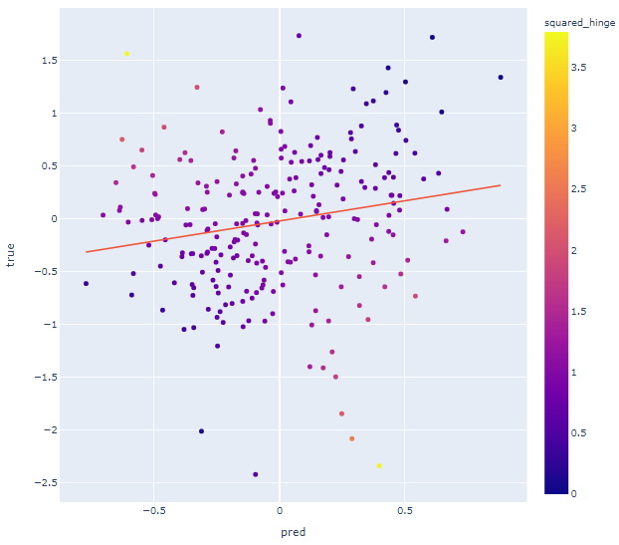
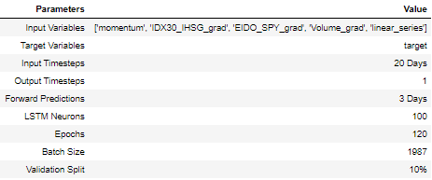
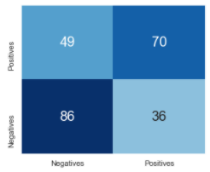
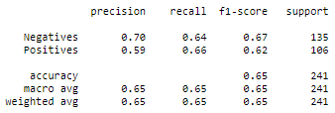
Test Result with `linear_series` feature
Model Parameters
Overall Accuracy

Slide 5
Conclusions
There seems to be higher accuracy by using `linear_series` feature, from 1-3 run the accuracy range is between 64-66%. Need to run simulation with 20 iteration to get statistically significant result.
`Volume_ma` feature may not increase accuracy in model, results from 3 runs indicate that the result is the same with or without `Volume_ma` feature in model.

